Slide 1

Department of Information and Communication Technology Course Code: ICT-3204 Course Name: Web Application Development Lab Presentation Topic: Student Management System
Presented By
Md. Firoj Mahmud
IT22050
year: 3rd
Semester: 2nd
Session: 2021-22
Presented To
Md. Anowar Kobir
Lecturer
Dept. of ICT
Mawlana Bhashani Science and Technology University

Slide 2
Introduction
The Smart Student Management System (SMS) is a comprehensive web platform built with Node.js, Express, and MySQL to digitize academic activities between teachers and students.
It provides role-based dashboards where teachers can manage student records, mark daily attendance with auto-calculated percentages, and enter exam marks with automatic grade generation.
Teachers also get powerful analytics including class performance trends, topper lists, at-risk student alerts, and Excel export functionality.
Students can view their personal dashboard with attendance history, digital marksheet (subject-wise marks & GPA), and visual performance graphs using Chart.js.
The system includes intelligent features like AI-style failure prediction, strength/weakness analysis, and automatic warnings for low attendance (<75%) or poor marks.
Security is handled via JWT authentication, password hashing (bcryptjs), and strict role-based access control for all API endpoints.
The frontend is a single-page application (SPA) using vanilla HTML, CSS, and JavaScript with a responsive, modern gradient UI.

Slide 3
Problem Statement
Manual record keeping causes data loss, errors, and wasted time.
No real-time attendance tracking delays identifying students with low attendance.
Manual grade calculation leads to inconsistent and incorrect results.
Students cannot access their own attendance, marks, or performance data.
No automated warning system for at-risk students or weak subjects.
Difficult to generate class analytics, toppers lists, or export reports.

Slide 4
Objectives
Digitize and centralize all student records securely.
Automate daily attendance tracking with percentage calculation.
Implement automatic grade and GPA calculation from marks.
Provide students self-service access to their own performance data.
Generate automatic alerts for low attendance and at-risk students.
Enable class analytics, toppers list, and Excel report export.
Ensure role-based secure access using JWT authentication.

Slide 5
Key Features
Teacher Features:
Verify uploaded materials – Review and approve student submissions.
Manage student requests – Track and respond to resource requests.
Upload requested resources – Share learning materials based on student needs.
Ensure content quality – Check standards and detect duplicate uploads.
Monitor system activity – Track platform usage and student engagement.

Slide 6
Key Features
Student Features:
Request learning resources – Submit requests for specific study materials or references.
Upload assignments/materials – Share completed work or resources with teachers for review.
View approved materials – Access verified learning resources uploaded by teachers.
Track request status – Check whether resource requests are pending, approved, or rejected.
Receive notifications – Get alerts when teachers upload requested materials or provide feedback.
View activity history – See past requests, uploads, and teacher responses.

Slide 7
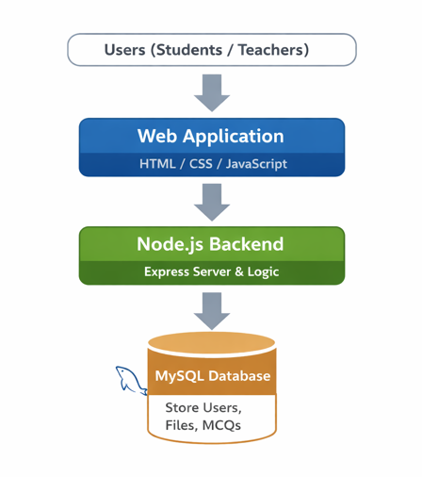
System Overview and Technologies Used

Slide 8
System Overview and Technologies Used
Two user roles: Student & Teacher
User interacts with web application
Backend processes requests
Data stored in MySQL database
System returns results dynamically
System ensures authentication

Slide 9
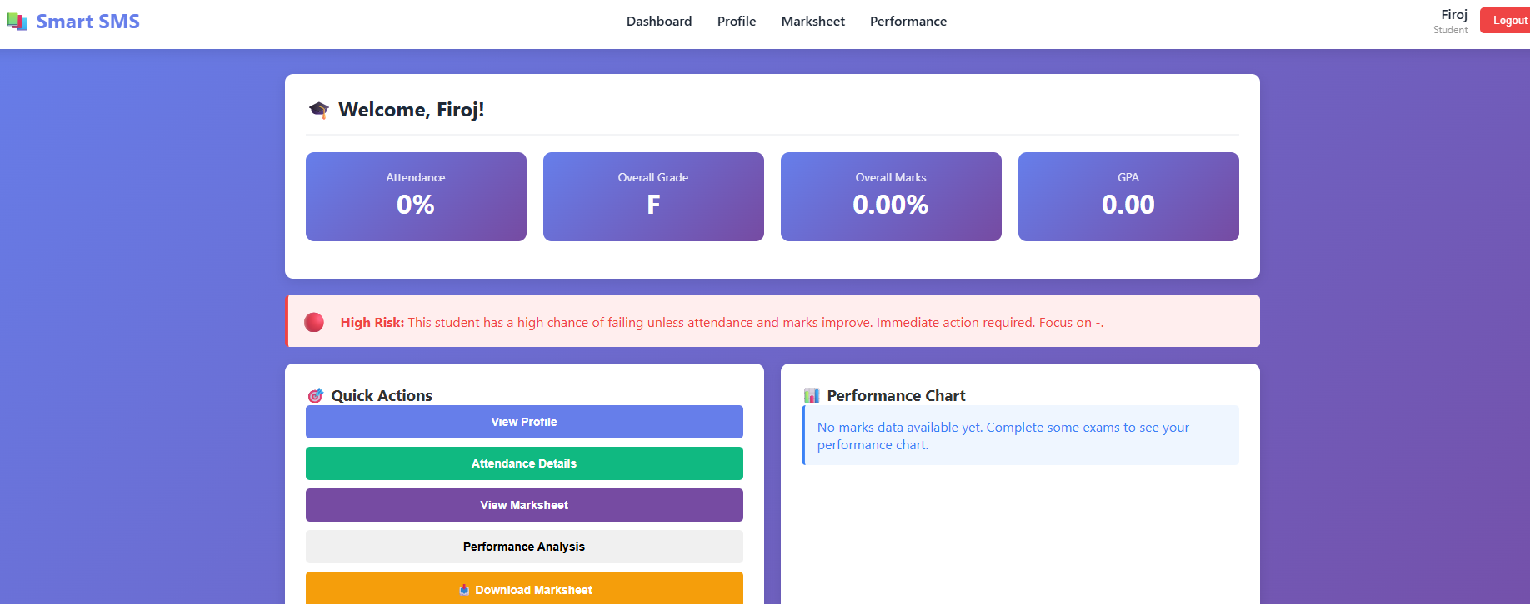
System Demonstration: student Management System

Slide 10
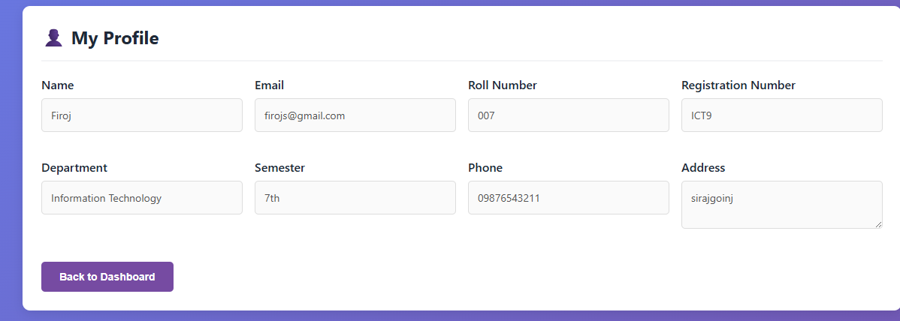
System Demonstration

Slide 11
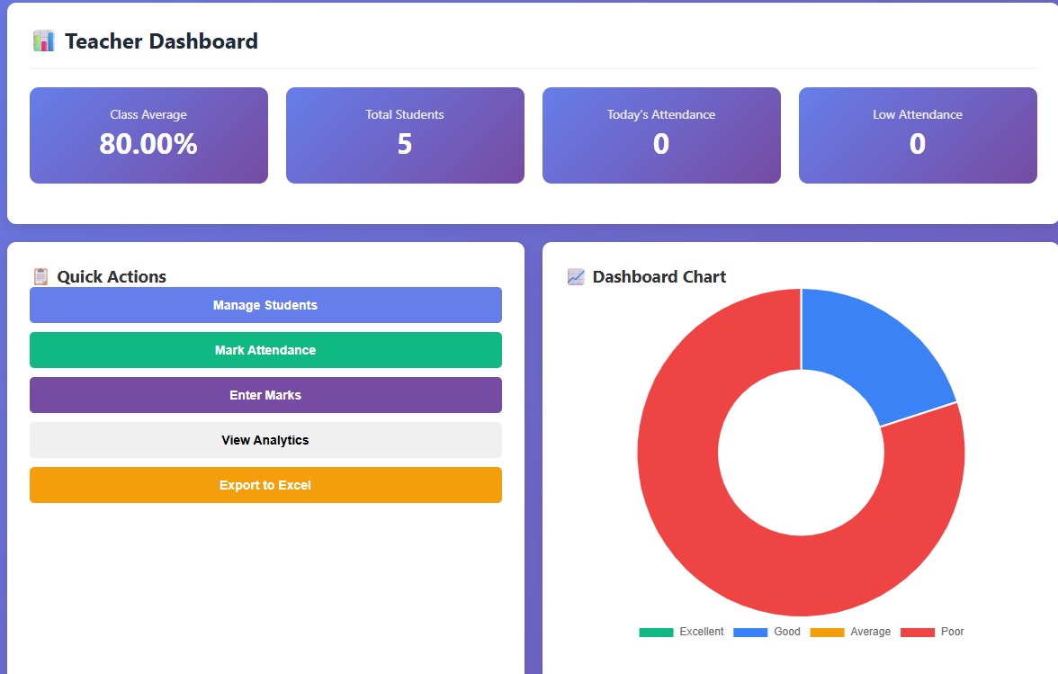
System Demonstration

Slide 12
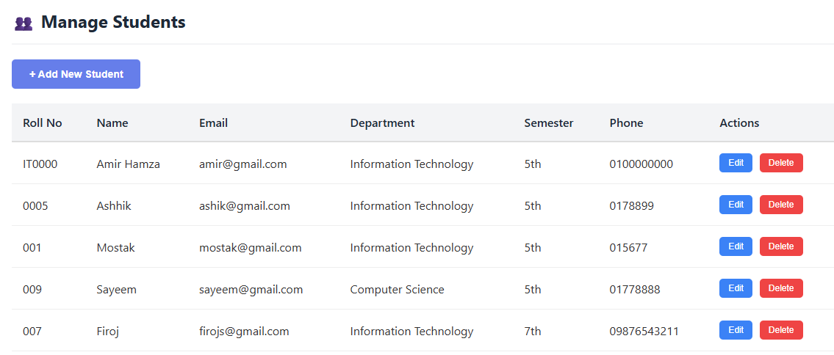
System Demonstration

Slide 13
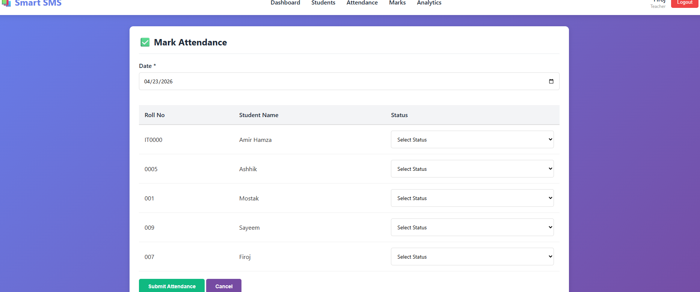
System Demonstration

Slide 14
limitations
No real-time email/SMS notifications
Poor scalability for large user bases (1000+ students)
No dedicated mobile app (Android/iOS)
No parent/guardian access portal
Requires continuous internet/database connection
PDF marksheet download not fully implemented
No automated backup and recovery
No bulk student import from CSV/Excel
Limited to English language only
No offline mode support

Slide 15
Future Work
Develop mobile apps – Create dedicated Android and iOS applications for students and teachers.
Implement real-time notifications – Add email, SMS, and push notifications for attendance alerts and resource updates.
Add parent/guardian portal – Allow parents to monitor their child's attendance, marks, and performance.
Enable bulk data import – Support CSV/Excel upload for批量 student account creation and marks entry.
Integrate AI-based predictions – Enhance failure prediction with machine learning for more accurate at-risk student identification.

Slide 16
links
https://lab-project-final-webapp.onrender.com
https://github.com/Firoj22050/Lab-Project_Final_WebApp

Slide 17
Summary
Web-based platform built with Node.js, Express, and MySQL
Provides role-based dashboards for teachers and students
Automates attendance tracking, grade calculation, and GPA generation
Includes performance analytics with charts and Excel export
Students can view attendance history, marksheet, and AI-style predictions
Secured with JWT authentication and password hashing
Current limitations: no mobile app, no parent portal, no real-time notifications
Future work: mobile apps, SMS/email alerts, parent access integration

Slide 18


Thank you

